Slide 1

OUR TEAM & Supervisor
ABDUL QUDDOUS
36154
ABDULLAH BIN ATA
38602
Supervisor Name
NAEEM ABBAS

Slide 2

StockVision AI Stock Prediction
Welcome to StockVision AI , an innovative AI-driven stock prediction project. Our team is revolutionizing financial forecasting by integrating sentiment analysis with deep learning algorithms. We're excited to present our vision for the future of trading.

Slide 3

Table of Contents
Introduction
Existing System / Competitive Analysis
Problem Statement
Proposed Solution
Project Scope
System Architectural Design
Implementation Tools and Techniques
Project Plan – WBS & Gantt Chart

Slide 4

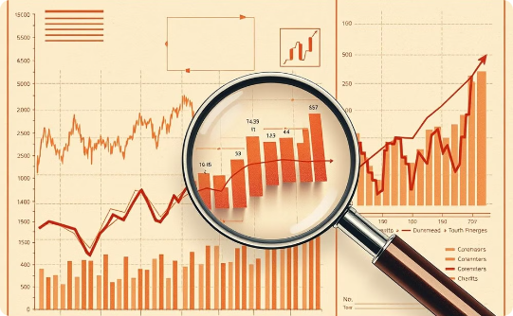

Introduction
Project Overview
Objective
Target Audience
StockVision AI uses sentiment analysis and deep learning to predict stock prices. Our goal is to make trading easier and more profitable.
We want to make stock predictions more accurate by combining financial data with real-time sentiment analysis.
We are helping traders, financial analysts, and investors make better decisions by providing them with insights and predictions.

Slide 5
Existing System / Competitive Analysis
Traditional Stock Forecasting
AI-Powered Competitors
Sentiment Analysis
Several AI-driven stock prediction platforms exist, offering varying levels of accuracy and features. We analyzed their strengths and weaknesses to inform our approach.
We identified a gap in the market for platforms leveraging sentiment analysis to understand market trends and investor sentiment.
Traditional methods rely on fundamental analysis, technical indicators, and expert opinions. However, these methods can be subjective, time-consuming, and prone to errors.

Slide 6
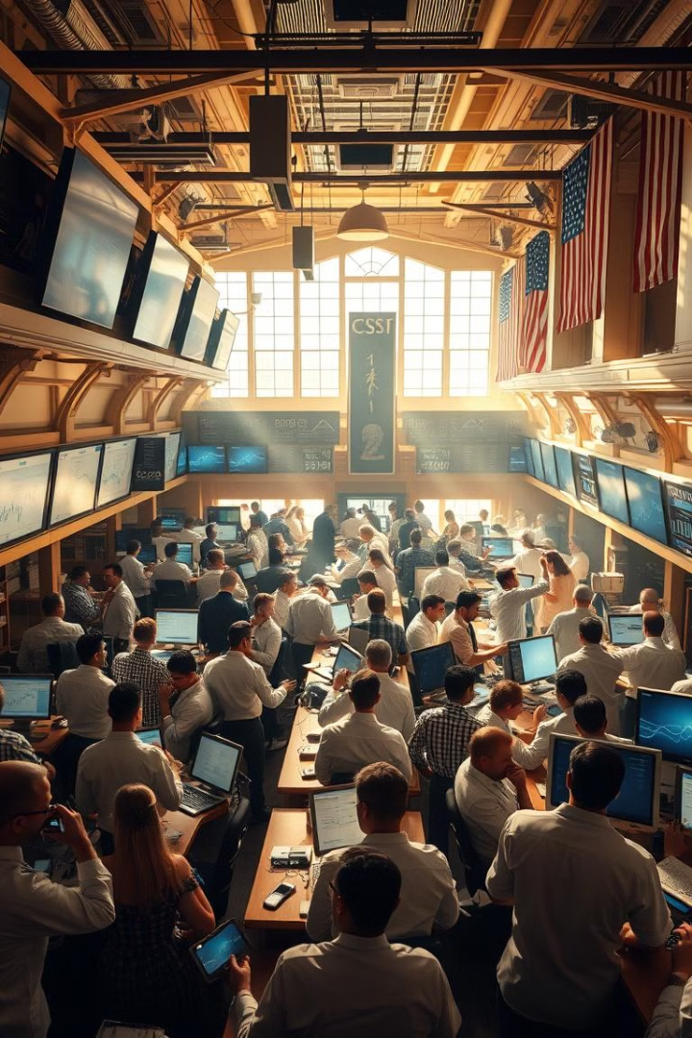
Existing System / Competitive Analysis
Current Systems
Competitors
Limitations
ARIMA
Alpaca
Limited real-time integration
LSTM
Kavout
Less accurate in volatile markets
Historical data models
Trefis
Ignores sentiment factors

Slide 7
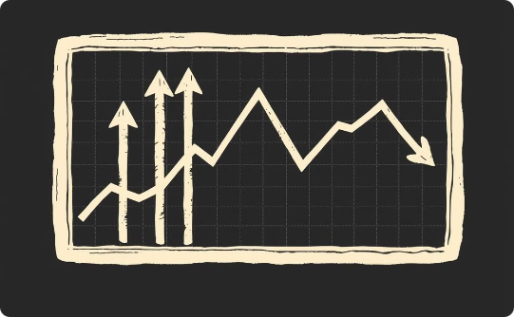
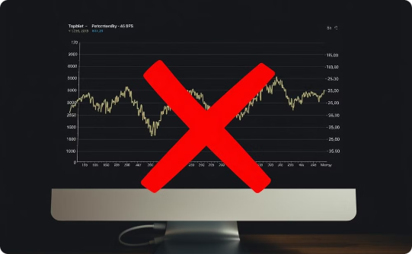

Problem Statement
Stock Prices Fluctuate
Current Models are Limited
We Need a Better Solution
Stock prices change quickly, often due to sentiment and things happening outside of the market.
Current models don't always consider real-time sentiment and global events, making their predictions less accurate.
We need a model that combines sentiment analysis to improve predictions.

Slide 8
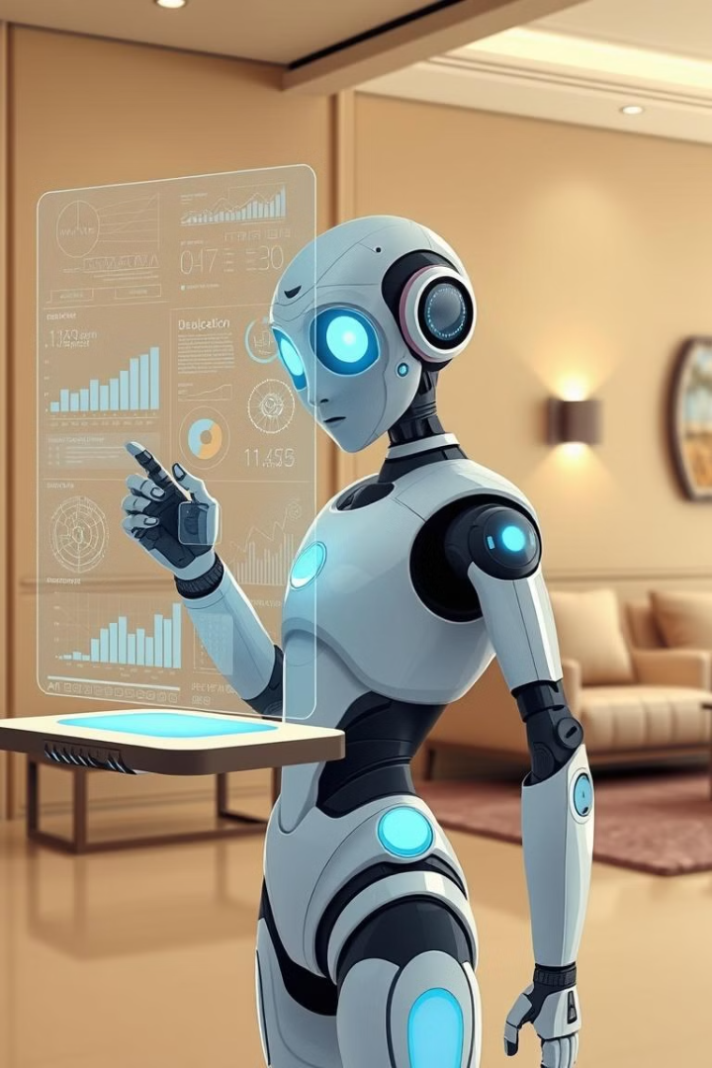
Proposed Solution
Data Fusion
Advanced Models
We'll combine sentiment data from news and social media with historical price data.
Utilizing deep learning models like LSTM and GRU for enhanced prediction accuracy.
Automated Trading
Seamless integration with Alpaca API enables automated trading based on our predictions.

Slide 9

Project Scope
1
Data Collection
Gather historical stock prices, social media sentiment, and news data.
2
Model Development
Implement LSTM and GRU models for accurate stock prediction.
3
User Interface
Create a React-based frontend for intuitive prediction visualization and trading options.
4
Cloud Deployment
Host the entire system on AWS for scalability and reliability.

Slide 10
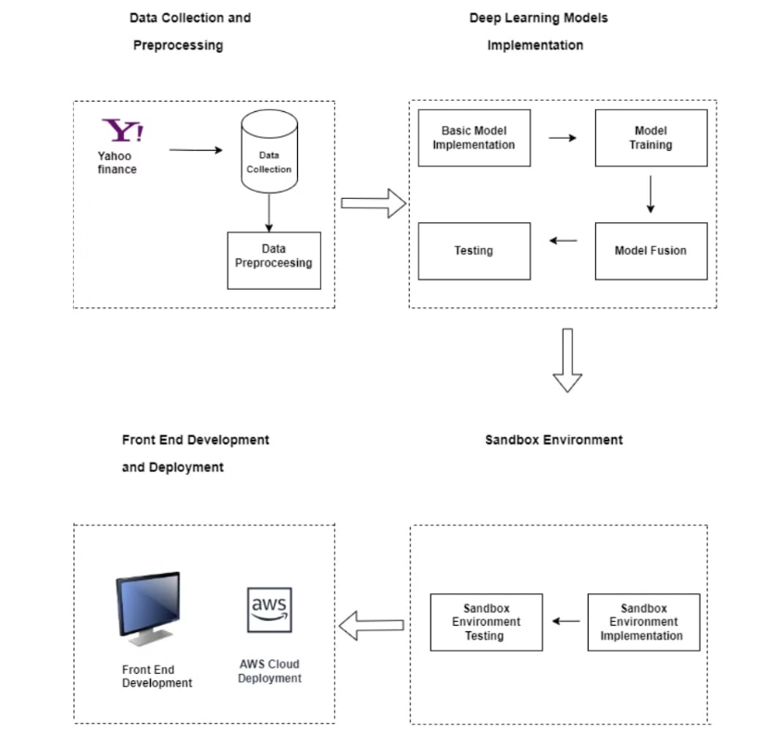
System Architectural Design

Slide 11
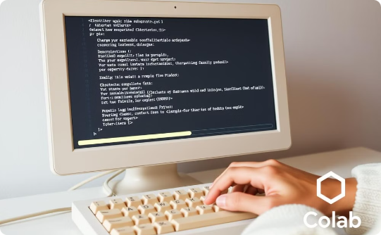

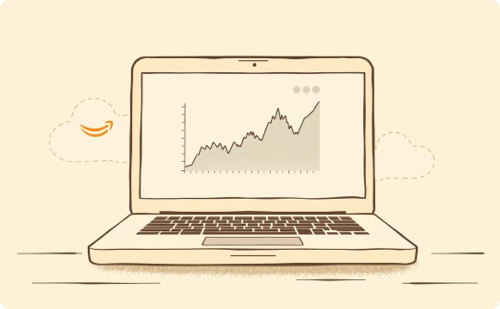
Implementation Tools and Techniques
Development Platforms
Core Technologies
Frontend & Deployment
Google Colab, Visual Studio Code, and Jupyter Notebook are used for collaborative coding and analysis.
Python, with libraries like Keras, TensorFlow, NumPy, and Pandas, are used for robust data processing and modeling.
React and JavaScript are used for the UI, with AWS cloud services for scalable deployment.

Slide 12

Project Plan – Work Breakdown Structure (WBS)
1
Project Management
Oversee timelines, resource allocation, and milestone tracking throughout the project lifecycle.
2
System Development
Implement data collection, model development, and user interface components.
3
Testing & Deployment
Conduct rigorous testing and deploy the system on AWS cloud infrastructure.
4
Final Review
Perform comprehensive review, documentation, and prepare for final submission.

Slide 13
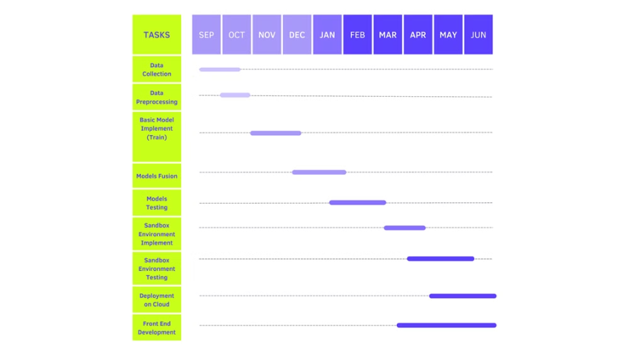
Gantt Chart:

